Slide 1
Finding and Using FSO Data
Recipes for Snackers and Gourmets
Alain Nadeau, Armin Grossenbacher
28.06.2012, opendata.ch, Zurich

Slide 2
On Journalists and Cooking
Gut verdauliche Rezepte statt Datenbrei und Zahlensalat
Gut verdauliche Rezepte:
Precisely the table I need for my article, ready to insert and reuse
Datenbrei, Zahlensalat:
Everything else
With FSO Data, cooking your own has never been easier, be it a quick snack or a gourmet meal. Most ingredients are already there, or will be in the near future...

Slide 3
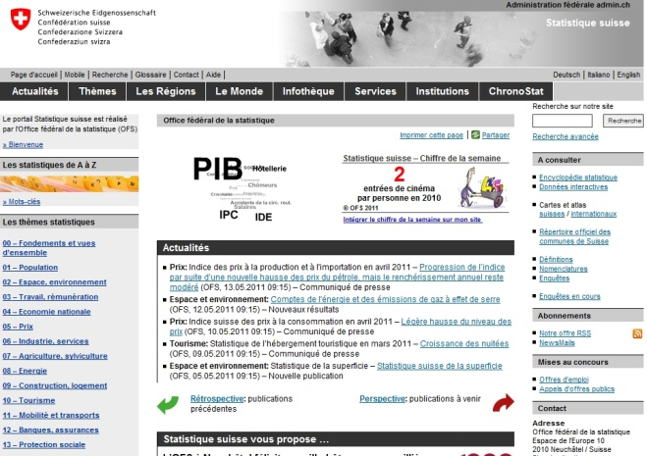
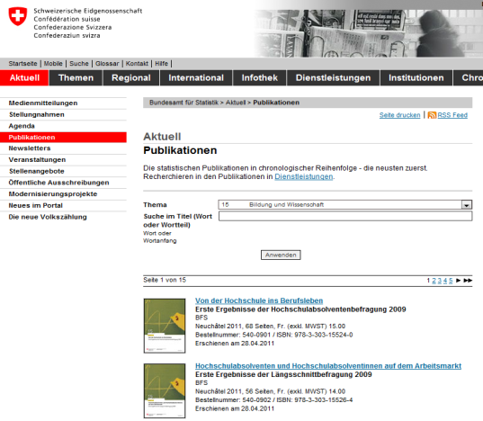
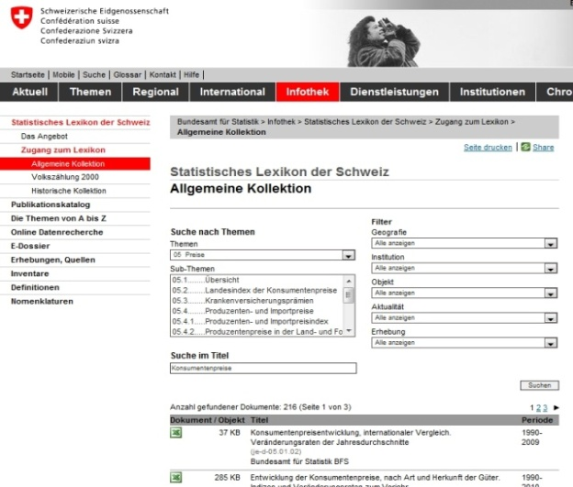
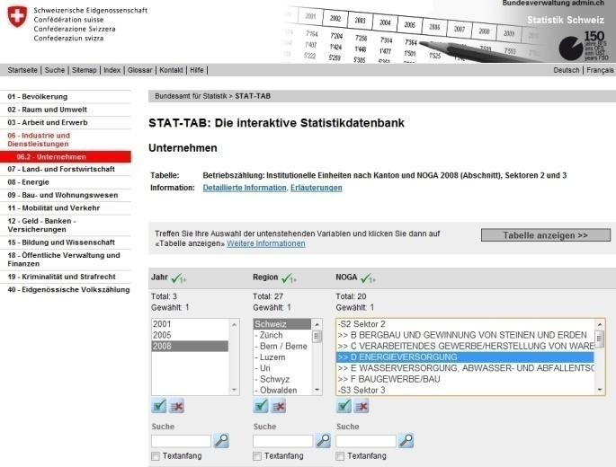
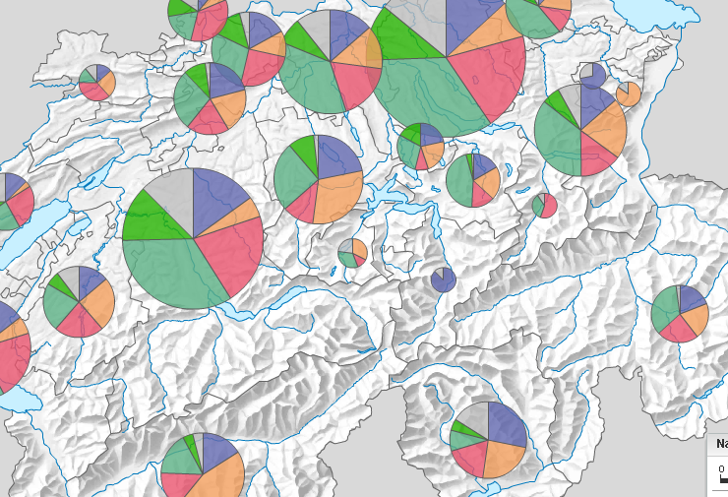
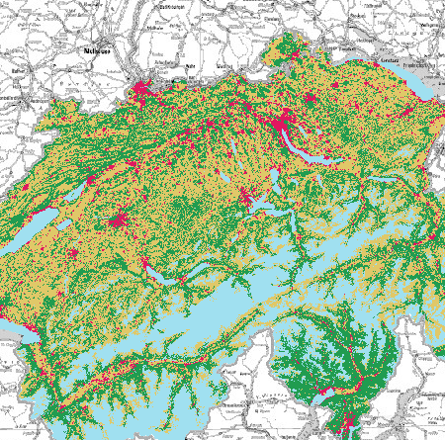
Statistikdaten längst open: www.statistik.ch
www.statistik.ch
Mehr als 50‘000 Seiten
in DE, FR, (IT, EN, RM)
Tausende Statistik-
publikationen als PDF
80’000 Tabellen im Statistischen Lexikon
Die öffentliche Statistik hat Daten als ihr Geschäft,
open data
„im Blut“
Viele statistische Daten sind frei zugänglich.
Stat-Tab > 200 Cubes zum interaktiven Tabellieren
Visualisierungen mit Datendownload : Stat@las
Geodaten: Arealstatistik
Volkszählungen seit 1850
Mikrodaten für die Forschung (nur Public Use Samples)
Notes:
Diese Statistikdaten sind für verschiedene Zielgruppen in unterschiedlicher Art bereitgestellt.
Zentraler Einstieg ist das Portal Statistik Schweiz, welches vom BFS betrieben wird.

Slide 4
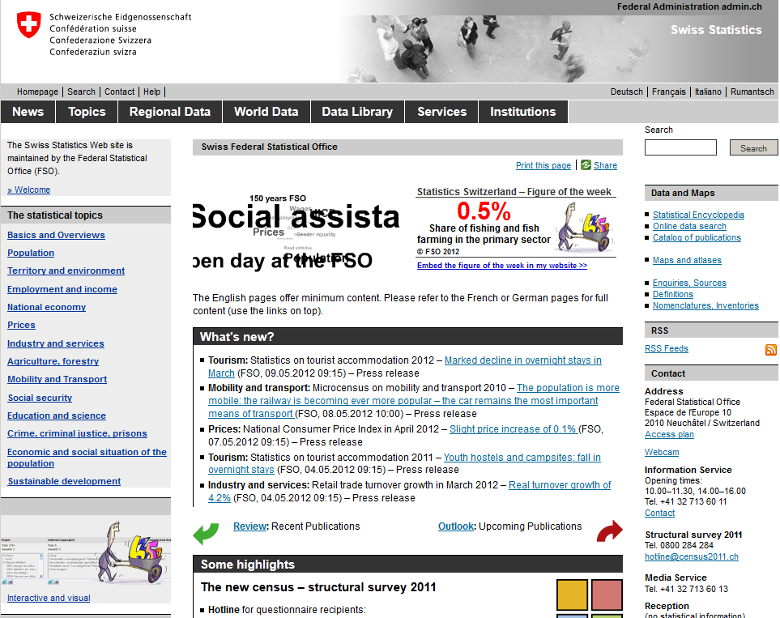
Accessing FSO Data on the Web

Slide 5

The five stars of data access
✰ | Make your stuff available on the web, whatever format;
 | Make it available as structured data (e.g., Excel instead of image scan of a table);
 | Use non-proprietary formats (e.g., CSV instead of Excel);
 | Use URIs to identify things, so that people can point at your stuff;
 | Link your data to other data to provide context
Sir Timothy John "Tim" Berners-Lee
How does the FSO rate according to this qualitative framework?
Use case: population of Switzerland by Canton on 31.12.2010

Slide 6

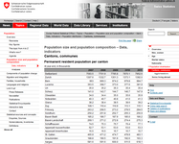
✰ Make your stuff available on the web, whatever format
PDF Files offered on FSO Portal: ca. 14'000 (4'500 publications, 7'700 Press releases, 1'100 various documents);
Web pages: ca. 50'000, 20 to 30% of which offer a static table
Link
Link

Slide 7
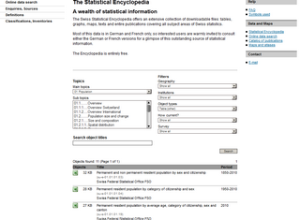
✰  Make it available as structured data (e.g., Excel)
Statistical Encyclopedia of Switzerland
Offers ca. 75'000 objects
55'453 Excel tables
Global, local, atomic access

Slide 8
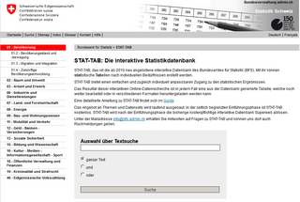
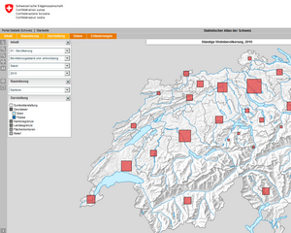
 Use non-proprietary formats
(e.g., CSV)
Statistical Encyclopedia ca. 150 CSV;
but...
STAT-TAB: 1'000 interactive multidimentional «Cubes» with CSV export;
Statistical Atlas of Switzerland: countless interactive maps with CSV export

Slide 9
 Use URIs to identify things, so people can point at your stuff;
Q. What does that mean ?
A. Linked Data ( «The Semantic Web» )

Slide 10
Linked Data in a nutshell
Data is organized semantically according to a pattern in three parts:
Subject Predicate Object
cat eats mouse
Thurgau Pop-2010 248444
<http://www.bfs.admin.ch/data/canton/TG>
<http://purl.org/linked-data/sdmx/2009/dimension#population-2010>
<http://www.bfs.admin.ch/dataset/01-2A01/2010/Total/swiss-foreigner/man-woman/permanent/4999-TG/>
Link

Slide 11
 Link your data to other data to provide context
<http://www.bfs.admin.ch/data/canton/TG> <http://www.detsatis.de/data/land/saarland> <http://www.insee.fr/data/dept/correze>
<http://uri.org/universal-predicate/population-2010>
<http://www.bfs.admin.ch/dataset/01-2A01/2010/Total/swiss-foreigner/man-woman/permanent/4999-TG/>
< http://www.detsatis.de/data/pop-2010/land/saarland />
<http://www.insee.fr/data/pop-2010/dept/correze>
Link

Slide 12
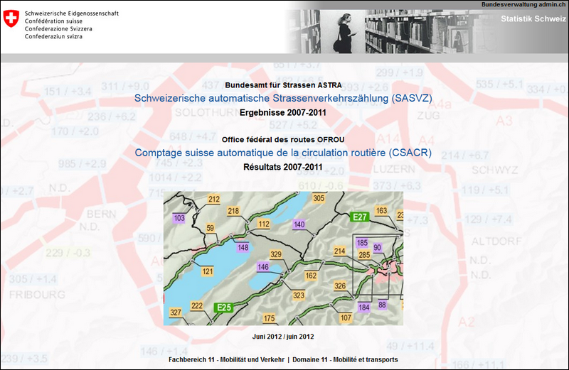
Special goody on Mobility
ASTRA / BFS
Schweizerische automatische
Strassenverkehrszählung (SASVZ)
(2007-2011)
Betw. 350 and 400 Zählstelle/year;
Number of vehicles by category, for every hour of every day since 2007 (almost complete);
Available in Access DBs;
Will be available in STAT-TAB;
CSV Version in preparation (6M records);
Linked Data Version would easily contain >250M triples;

Slide 13


Conclusion
Five stars?
One star

Slide 14
Thank you
Statistics Switzerland: http://www.bfs.admin.ch
Statistical Encyclopedia http://www.lexikon-stat.admin.ch
STAT-TAB http://www.stattab.bfs.admin.ch
Statistical Atlas of Switzerland http://www.atlas.bfs.admin.ch
ASTRA / Verkehrszählung http://www.portal-stat.admin.ch/sasvz/
Linked Data Portal Switzerland (Forthcoming)

